Slide 1
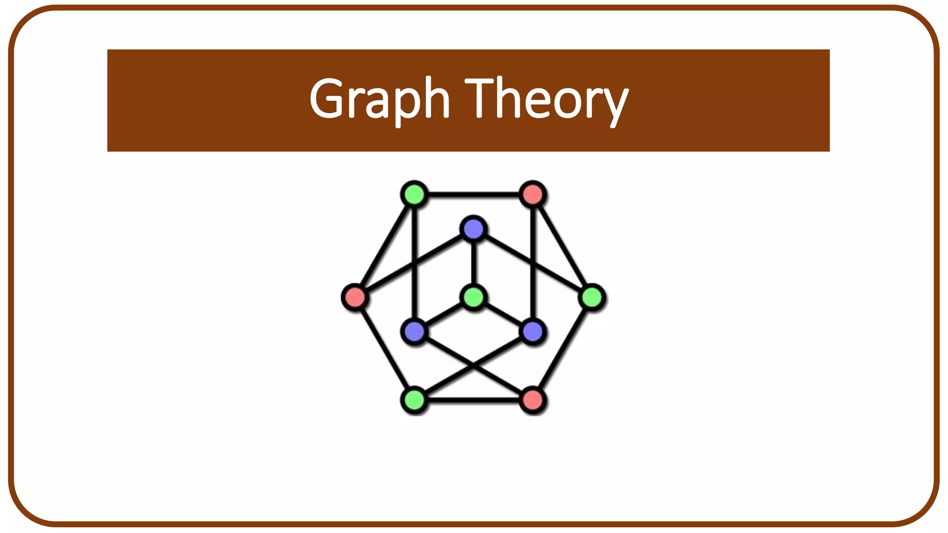

Slide 2
Contents
Definition and terminology
Graph representations (adjacency matrices, edge list, adjacency lists)
BFS/DFS algorithm, weaknesses, and alternatives
Summary/key points

Slide 3
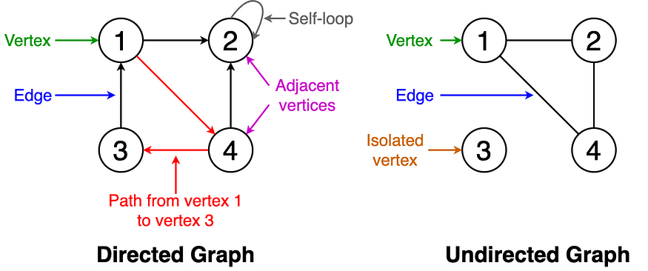
Introduction
What is a Graph?
A graph consists of a finite set of vertices or nodes and a set of edges connecting these vertices. Two vertices are said to be adjacent if they are connected to each other by the same edge.
Terminology of Graphs

Slide 4
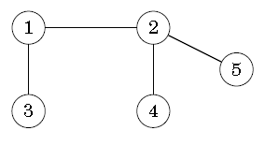
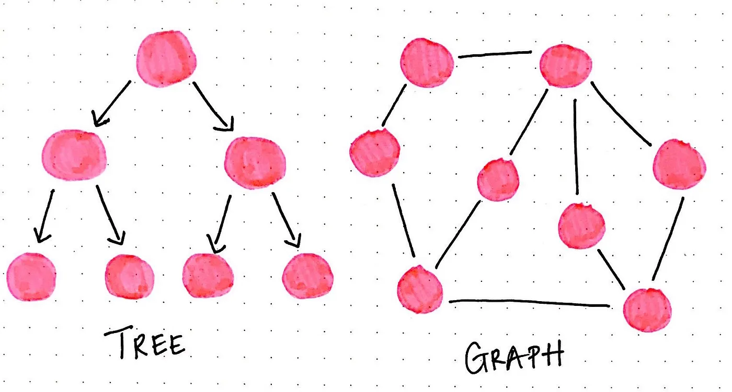
Tree
Trees, as we learned, start with a root node, and might connect to other nodes, which means that could contain subtrees within them.
Trees are actually a subset of graph. Trees are restricted types of graphs, just with many more rules to follow . A tree will always be a graph, but not all graphs will be trees.
What are these rules ?
G is connected and acyclic (contains no cycles)
G is connected and has n vertices and n − 1 edges.
Refer: https://en.wikipedia.org/wiki/Tree_(graph_theory)#Definitions

Slide 5
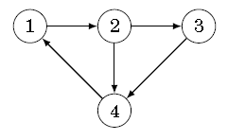
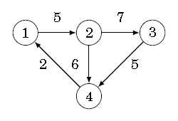
Graph representation
Adjacency matrix
Can be stored as two-dimensional array
Where each value adj[x][y] indicates whether the graph contains an edge from node x to node y
int adj[N][N];
 | 1 | 2 | 3 | 4
1 | 0 | 1 | 0 | 0
2 | 0 | 0 | 1 | 1
3 | 0 | 0 | 0 | 1
4 | 1 | 0 | 0 | 0
Pros: Simple, easy to implement, quickly check if two nodes have a direct edge or not in 0(1)
Cons: Large memory -> This representation cannot be used if the graph contain large number of nodes
Have to traverse all row or column of matrix to find all neighbors of a node -> O(n) time
If the graph is weighted
 | 1 | 2 | 3 | 4
1 | 0 | 5 | 0 | 0
2 | 0 | 0 | 7 | 6
3 | 0 | 0 | 0 | 5
4 | 2 | 0 | 0 | 0

Slide 6
Graph representation
Edge list
Can be stored in a vector
Where each pair(x, y) denotes that there is an edge from node x to node y
vector<pair<int, int>> edges;
edges.push_back({1, 2});
edges.push_back({2, 3});
edges.push_back({2, 4});
edges.push_back({3, 4});
edges.push_back({4, 1});
Pros: This is a convenient way if the algorithm only need to processes edges of the graph.
Cons: Have to traverse all edges in graph to find all neighbors of a node -> O(m) time
If graph is weighted
vector<vector<int>> edges;
edges.push_back({1, 2, 5});
edges.push_back({2, 3, 7});
edges.push_back({2, 4, 6});
edges.push_back({3, 4, 5});
edges.push_back({4, 1, 2});

Slide 7
Graph representation
Adjacency list
Can be stored in an array of vector or vector of vector
each node x in the graph is assigned an adjacency list that consists of nodes to which there is an edge from x
vector<int> adj[N];
adj[1].push_back(2);
adj[2].push_back(3);
adj[2].push_back(4);
adj[3].push_back(4);
adj[4].push_back(1);
Pros: Efficiently find the neighbors of nodes.
For example, the following for loop goes through all nodes to which we can move from node x:
→ This is the most popular way to represent graphs, and most algorithms can be efficiently implemented using them.
for (auto u : adj[x]) {
// process node u
}
If graph is weighted
vector<pair<int, int>> adj[N];
adj[1].push_back({2, 5});
adj[2].push_back({3, 7});
adj[2].push_back({4, 6});
adj[3].push_back({4, 5});
adj[4].push_back({1, 2});

Slide 8
Graph traversal
2 fundamental graph algorithms: depth-first search and breadth-first search.
Both algorithms are given a starting node in the graph, and they visit all nodes that can be reached from the starting node.
The difference in the algorithms is the order in which they visit the nodes.

Slide 9
Breadth-first search
Breadth-First Search is a graph traversal algorithm that explores all the vertices of a graph in breadth-first order. This means that BFS visits all the neighbors of a vertex before exploring the neighbors of the neighbors.
In other words, BFS traverses the graph in layers, starting from the source vertex and moving outwards.
BFS is particularly useful for finding the shortest path between two vertices in an unweighted graph or for determining if a path exists between two vertices.

Slide 10
Breadth-first search
Implementation:
Assumes that the graph is stored as adjacency lists and maintains the following data structures:
queue<int> q;
bool visited[N];
Queue q contains nodes to be processed in increasing order of their distance.
The array visited indicates which nodes the search has already visited.
visited[x] = true;
q.push(x);
while (!q.empty()) {
int s = q.front();
q.pop();
for (auto u : adj[s]) {
// process node u
if (visited[u]) continue;
visited[u] = true;
q.push(u);
}
}

Slide 11
Breadth-first search
Node | Distance
1 | 0
2 | 1
3 | 1
4 | 2
5 | 1
6 | 2
7 | 2
The time complexity of algorithm depends on the graph representation
Graph has n nodes and m edges
Adjacency matrix, time complexity is O(n*n)
Edge list, time complexity is O(n*m)
Adjacency list, time complexity is O(n+m) → most effecient

Slide 12
Depth First Search
Depth First Search is an algorithm for traversing or searching tree or graph data structure.
The algorithm starts at the root node and explore as far as possible along each branch before backtracking.

Slide 13
Depth First Search
Recursive Implementation
void dfs(int v) {
visited[v] = true;
for (int w : G[v]) {
if (visited[w]) continue;
dfs(w);
}
}

Slide 14
Depth First Search
Stack Implementation
void dfs(int v) {
stack S;
S.push(v);
while (!S.empty()) {
v = S.pop();
if (visited[v]) continue;
visited[v] = true;
for (int w : G[v]) {
S.push(w);
}
}
}

Slide 15
Depth First Search
Example
0 | 1,3,5
1 | 0,5
2 | 4,5,7
3 | 0
4 | 2,6,8
5 | 0,1,2,6
6 | 4,5
7 | 2,8
8 | 4,7
F
F
F
F
F
F
F
F
F
3
0
6
5
1
4
2
8
7

Slide 16
Depth First Search
Example
0 | 1,3,5
1 | 0,5
2 | 4,5,7
3 | 0
4 | 2,6,8
5 | 0,1,2,6
6 | 4,5
7 | 2,8
8 | 4,7
T
F
F
F
F
F
F
F
F
3
0
6
5
1
4
2
8
7
Dfs(0)

Slide 17
Depth First Search
Example
0 | 1,3,5
1 | 0,5
2 | 4,5,7
3 | 0
4 | 2,6,8
5 | 0,1,2,6
6 | 4,5
7 | 2,8
8 | 4,7
T
T
F
F
F
F
F
F
F
3
0
6
5
1
4
2
8
7
Dfs(0) -> Dfs(1)

Slide 18
Depth First Search
Example
0 | 1,3,5
1 | 0,5
2 | 4,5,7
3 | 0
4 | 2,6,8
5 | 0,1,2,6
6 | 4,5
7 | 2,8
8 | 4,7
T
T
F
F
F
T
F
F
F
3
0
6
5
1
4
2
8
7
Dfs(0) -> Dfs(1) -> Dfs(5)

Slide 19
Depth First Search
Example
0 | 1,3,5
1 | 0,5
2 | 4,5,7
3 | 0
4 | 2,6,8
5 | 0,1,2,6
6 | 4,5
7 | 2,8
8 | 4,7
T
T
T
F
F
T
F
F
F
3
0
6
5
1
4
2
8
7
Dfs(0) -> Dfs(1) -> Dfs(5) -> Dfs(2)

Slide 20
Depth First Search
Example
0 | 1,3,5
1 | 0,5
2 | 4,5,7
3 | 0
4 | 2,6,8
5 | 0,1,2,6
6 | 4,5
7 | 2,8
8 | 4,7
T
T
T
F
T
T
F
F
F
3
0
6
5
1
4
2
8
7
Dfs(0) -> Dfs(1) -> Dfs(5) -> Dfs(2) -> Dfs(4)

Slide 21
Depth First Search
Example
0 | 1,3,5
1 | 0,5
2 | 4,5,7
3 | 0
4 | 2,6,8
5 | 0,1,2,6
6 | 4,5
7 | 2,8
8 | 4,7
T
T
T
F
T
T
T
F
F
3
0
6
5
1
4
2
8
7
Dfs(0) -> Dfs(1) -> Dfs(5) -> Dfs(2) -> Dfs(4) -> Dfs(6)

Slide 22
Depth First Search
Example
0 | 1,3,5
1 | 0,5
2 | 4,5,7
3 | 0
4 | 2,6,8
5 | 0,1,2,6
6 | 4,5
7 | 2,8
8 | 4,7
T
T
T
F
T
T
T
F
F
3
0
6
5
1
4
2
8
7
Dfs(0) -> Dfs(1) -> Dfs(5) -> Dfs(2) -> Dfs(4)

Slide 23
Depth First Search
Example
0 | 1,3,5
1 | 0,5
2 | 4,5,7
3 | 0
4 | 2,6,8
5 | 0,1,2,6
6 | 4,5
7 | 2,8
8 | 4,7
T
T
T
F
T
T
T
F
T
3
0
6
5
1
4
2
8
7
Dfs(0) -> Dfs(1) -> Dfs(5) -> Dfs(2) -> Dfs(4) -> Dfs(8)

Slide 24
Depth First Search
Example
0 | 1,3,5
1 | 0,5
2 | 4,5,7
3 | 0
4 | 2,6,8
5 | 0,1,2,6
6 | 4,5
7 | 2,8
8 | 4,7
T
T
T
F
T
T
T
T
T
3
0
6
5
1
4
2
8
7
Dfs(0) -> Dfs(1) -> Dfs(5) -> Dfs(2) -> Dfs(4) -> Dfs(8) -> Dfs(7)

Slide 25
Depth First Search
Example
0 | 1,3,5
1 | 0,5
2 | 4,5,7
3 | 0
4 | 2,6,8
5 | 0,1,2,6
6 | 4,5
7 | 2,8
8 | 4,7
T
T
T
F
T
T
T
T
T
3
0
6
5
1
4
2
8
7
Dfs(0)

Slide 26
Depth First Search
Example
0 | 1,3,5
1 | 0,5
2 | 4,5,7
3 | 0
4 | 2,6,8
5 | 0,1,2,6
6 | 4,5
7 | 2,8
8 | 4,7
T
T
T
T
T
T
T
T
T
3
0
6
5
1
4
2
8
7
Dfs(0) -> Dfs(3)

Slide 27
Depth First Search
Example
0 | 1,3,5
1 | 0,5
2 | 4,5,7
3 | 0
4 | 2,6,8
5 | 0,1,2,6
6 | 4,5
7 | 2,8
8 | 4,7
T
T
T
T
T
T
T
T
T
3
0
6
5
1
4
2
8
7
Complete!

Slide 28
Comparing BFS and DFS
BFS and DFS have different traversal orders and use different data structures for their implementation. Here’s a quick comparison of BFS and DFS:
BFS visits all the vertices in layers, moving outwards from the source vertex, while DFS goes as deep as possible before backtracking to explore other branches.
BFS uses a queue data structure, while DFS uses a stack or recursion.
BFS can find the shortest path between two vertices in an unweighted graph, while DFS is more suitable for problems like finding connected components, and detecting cycles in a graph.
Choosing between BFS and DFS
If the problem requires finding the shortest path in an unweighted graph, BFS is the natural choice. For problems like cycle detection, DFS is more appropriate.

Slide 29
Summary
Graphs are comprised of a set of nodes, also called vertices, and edges, or connections between the nodes. Trees are subset of graphs, are types of graph with some rules
Three representations of graphs (edge list, adjacency matrices and adjacency lists). The adjacency lists take less space and use efficiently with BFS/DFS algo.
By understanding the differences between these two algorithms and how to implement them, you’ll be well-equipped to tackle a wide range of graph problems.

Slide 30
FAQ
Q: Can BFS be used for cycle detection in a graph?
A: Yes, BFS can be used for cycle detection in both directed and undirected graphs. However, DFS is often more convenient for this purpose.
Q: Can DFS be used to find the shortest path in a graph?
A: DFS is not suitable for finding the shortest path in an unweighted graph, as it does not guarantee that the first path found will be the shortest. Instead, use BFS for this purpose. For weighted graphs, use algorithms such as Dijkstra’s or Bellman-Ford.
Q: How do I choose between recursive and iterative DFS?
A: Recursive DFS is often easier to implement and understand, but it may run into stack overflow issues for very deep graphs due to the limited recursion depth. Iterative DFS using an explicit stack data structure avoids this issue and can handle deeper graphs. In general, choose the implementation that best suits your problem and performance requirements.

